Slide 1
Lab C : Color Detection
胡晉瑄 林修賢
INSTRUCTOR: Professor Jiin Lai

Slide 2
Overview
Background Introduction
Performance Analysis
Result of color detection
Suggestion for Improvement

Slide 3
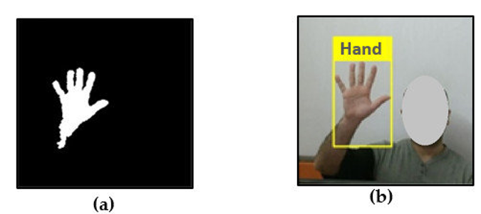
Color Detection
The Color Detection algorithm is basically used for color object tracking and object detection, based on the color of the object. The color based methods are very useful for object detection and segmentation, when the object and the background have a significant difference in color.

Slide 4
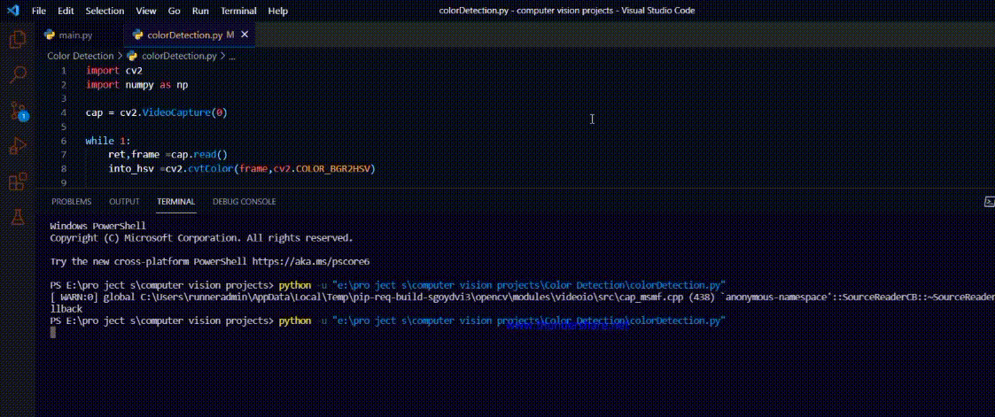
Why FPGA acceration for color detection?
Nowdays, object detection by color is widely use in many field, such as image annotation, vehicle counting, face detection and also using in tracking objects.
We can find that most of above application are video type and have a real-time need. However, CPU is not suitable for such kind computation. FPGA can solve this problem, we can design a specialized architecture for color detection. With FPGA, we could:
Increase the throughput of applications (FPS )
Shorten the latency for computing (real time)
Utilize hardware of FPGA for data parallelism

Slide 5
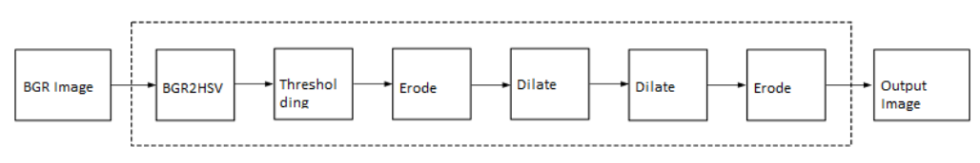
Flow of Color Detection
The color space of the original BGR image is converted into an HSV color space.
BGR2HSV
Applying the thresholding operation on the HSV image and return either 255 or 0.
Thresholding
Applying morphological operation, reducing unnecessary white patches (noise) in the image.
Morphological Opening: Erode -> Dilate
Morphological Closing : Dilate -> Erode
opening operation
closing operation

Slide 6
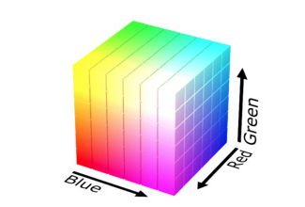
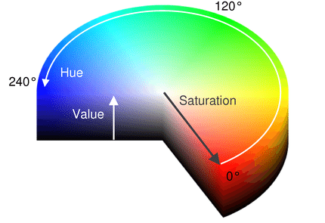
Convert BGR to HSV
Why HSV?
HSV color space is useful for working with color information. It stands for HUE, SATURATION, and VALUE (or brightness). It is very useful in image processing tasks that need to segment objects based on its color
HUE : The hues are modeled as an angular dimension that encodes color information.
SATURATION : Saturation encodes the intensity of color.
VALUE : Value represents the amount to which that respective color is mixed with black.
RGB colorspace are coded using the three channels, it is more difficult to segment an object based on its color.
RGB colorspace
HSV colorspace

Slide 7
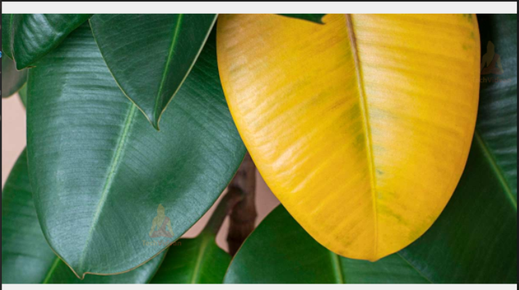
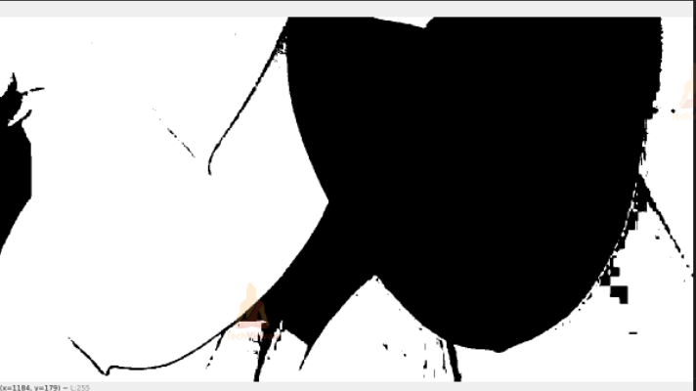
Thresholding
Set lower bound and upper bound of detecting objection.
Get a binary mask of the frame where the target color is present
Ex: As following example, we set the lower bound to [50, 20, 20], upper bound to [100, 255, 255] (bound for leaves) .
Then, we can use thresholding function to filter the image.
255(white) is for targeting color, 0(black) is for the other color.

Slide 8
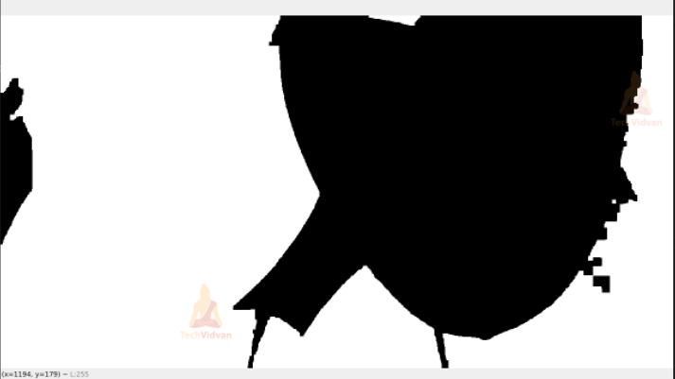
Morphological Opening & Closing
In the original mask, we can see that there is lots of unnecessary noise. So we have to remove it to get a better result.
Morphological Opening:
Eroding and then dilating. It is aimed to remove little white dot in the black region.
Morphological Closing :
Dilating and then Eroding. It is aimed to remove little black dot in the white region.
Morphological operation

Slide 9
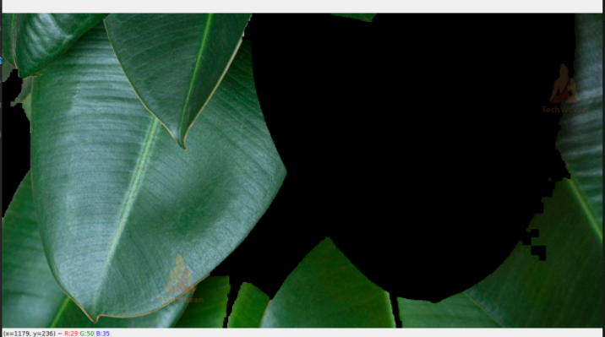
Flow result

Slide 10
Hardware Functions
The Color Detection example uses five hardware functions from the Vitis vision library. They are:
Array2xfMat
BGR2HSV
colorthresholding
erode
dilate

Slide 11
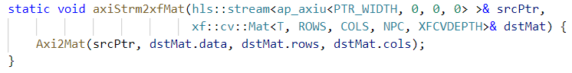
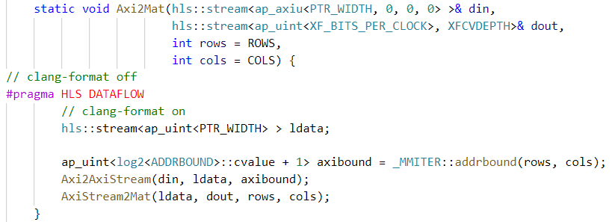
Kernel Functions - Array2xfMat
Input a 1D array
MAXI in - stream out
fill with a 2D matrix
Notes:
Vitis_Libraries/vision/L1/include/common/xf_structs.hpp

Slide 12
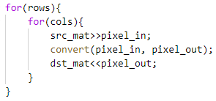
Kernel Functions - bgr2hsv
Pseudo code
Img
Convert
Img_out
In bgr2hsv function, it will stream in every bgr pixels and calculate its corresponding hsv representation and then stream out.
Notes:
Vitis_Libraries/vision/L1/include/imgproc/xf_bgr2hsv.hpp

Slide 13
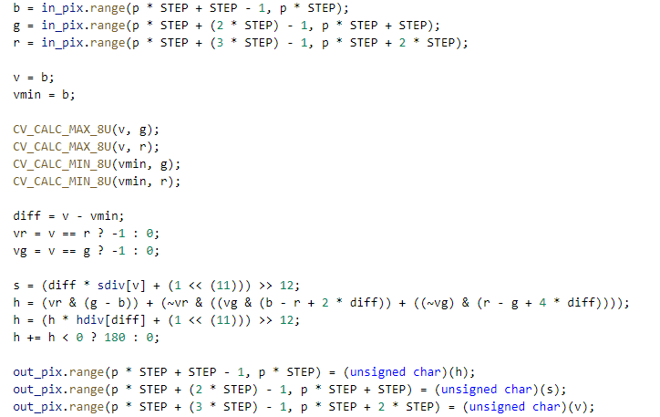
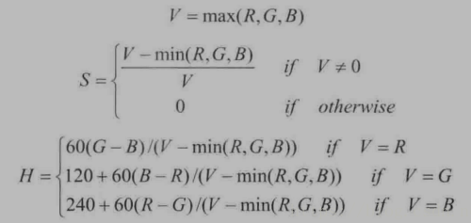
Kernel Functions - bgr2hsv convertion

Slide 14
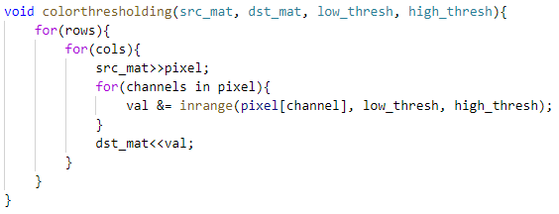
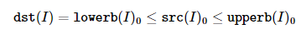
Kernel Functions - colorthresholding
Pseudo code
…
In colorthresholding function, it is typically used to get a binary image out of a image or for removing a noise, that is, filtering out pixels with too small or too large values

Slide 15
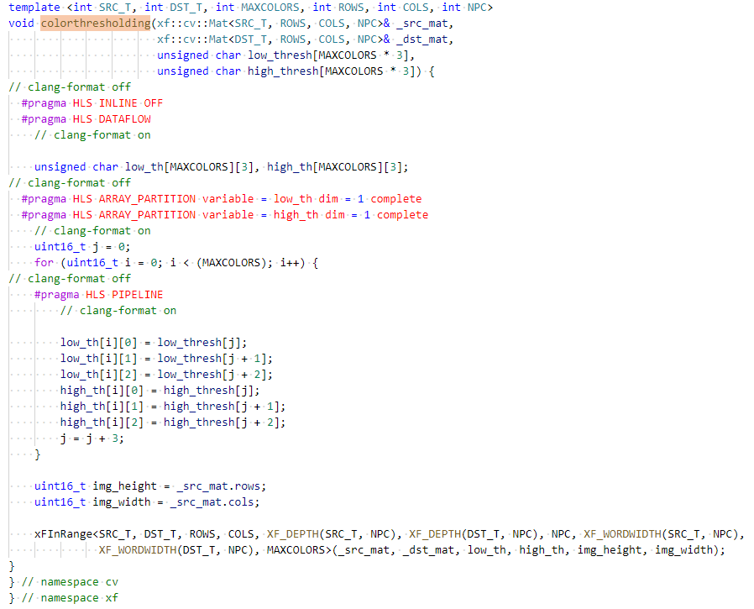
set the threshold
use InRange to filter out
Notes:
Vitis_Libraries/vision/L1/include/imgproc/xf_colorthresholding.hpp

Slide 16
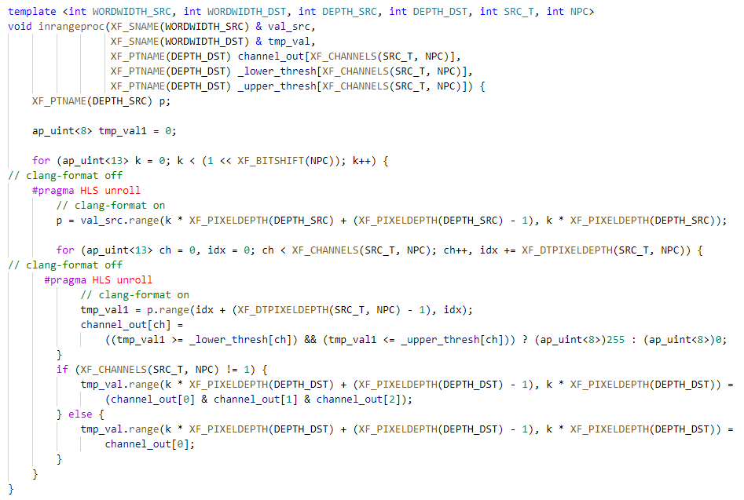
set in-range channel to 1
& all the channel and get the result

Slide 17
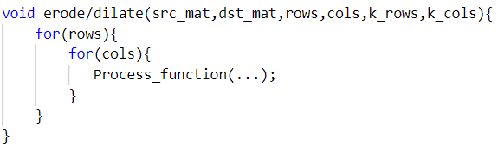
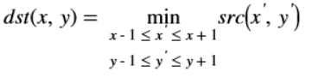
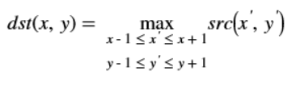
Kernel Functions - erode/dilate
erode
dilate
Pseudo code
kernel erode and kernel dilate have same architecture, the only difference is function_apply in the process_function.
Notes:
erode : Vitis_Libraries/vision/L1/include/imgproc/xf_erosion.hpp

Slide 18
Dataflow of Dilation and Erosion
read
shift
out
extract
src_buf
buf
extract
buf
buf_copy
Dilation/ Erosion
write
buf
apply

Slide 19
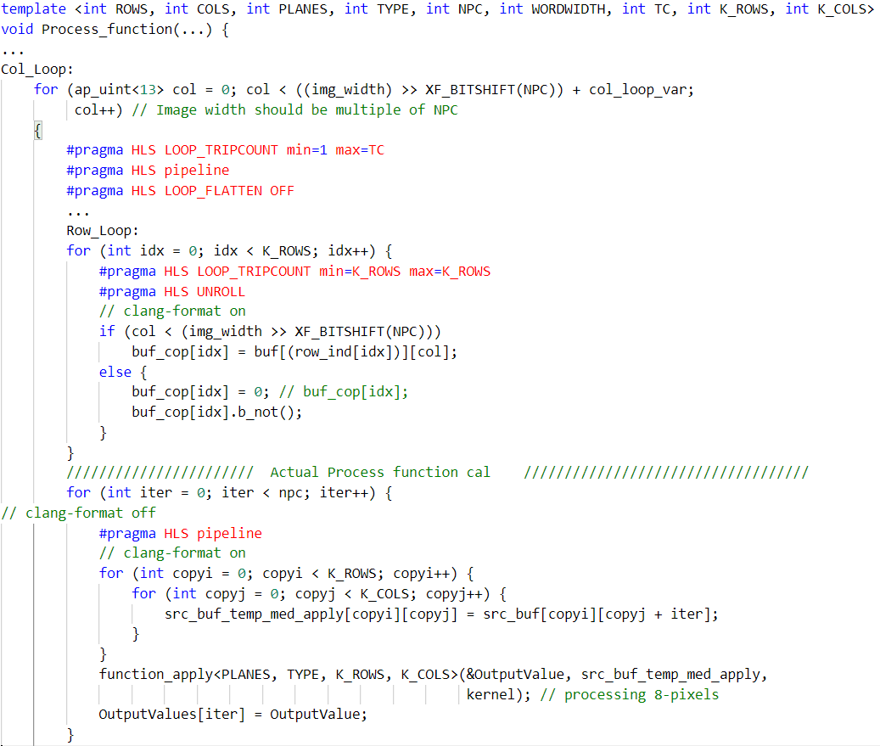
padding over bounding value with 0
copy data to kernel buffer from src
run function_applt & write back
Notes:
erode : Vitis_Libraries/vision/L1/include/imgproc/xf_erosion.hpp

Slide 20
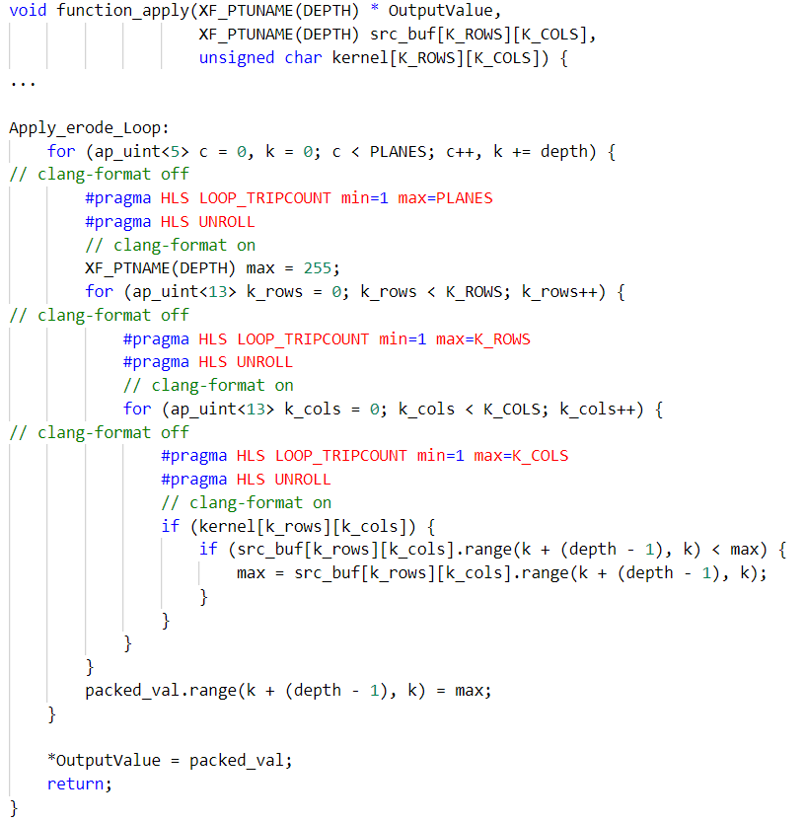
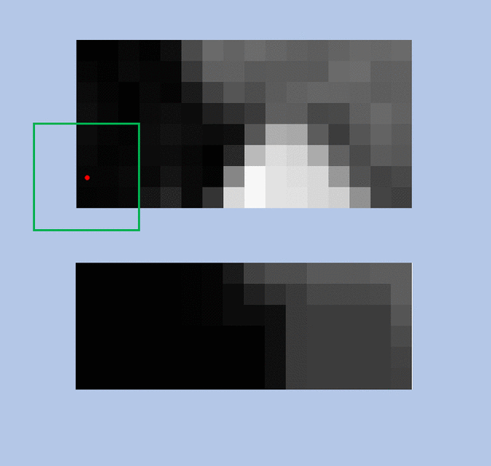
erode: function_apply
If any pixel in the kernel is 0,
output of this kernel would be set 0
Notes:
erode : Vitis_Libraries/vision/L1/include/imgproc/xf_erosion.hpp

Slide 21
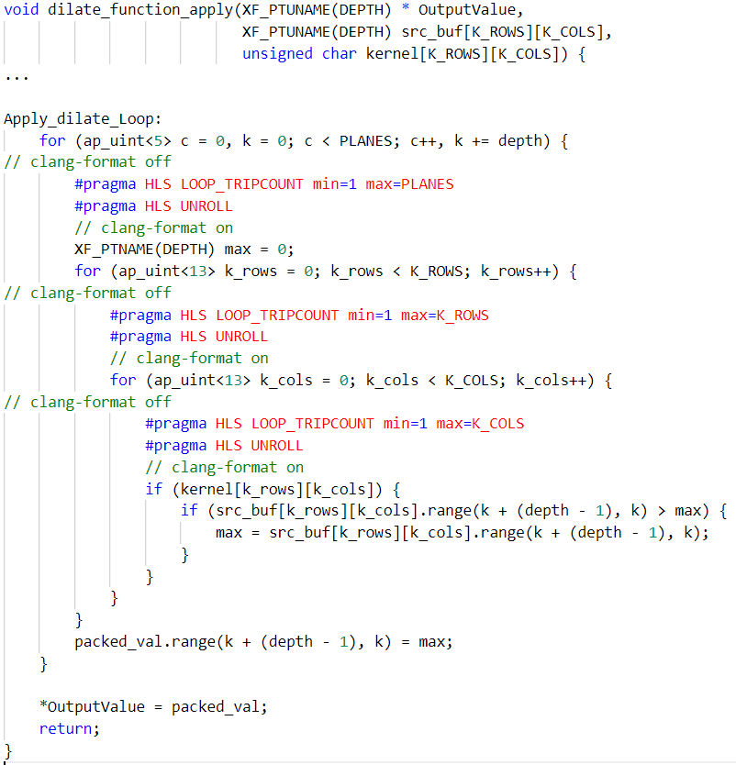
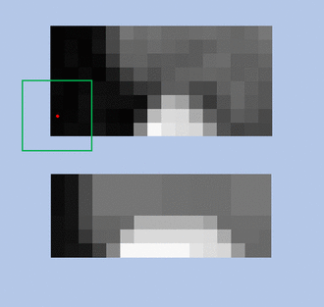
dilate: function_apply
If any pixel in the kernel is 255,
output of this kernel would be set 255
Notes:
erode : Vitis_Libraries/vision/L1/include/imgproc/xf_erosion.hpp

Slide 22
Performance Analysis

Slide 23
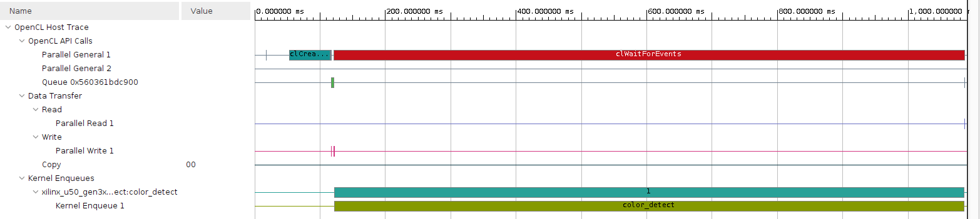
SW_emulation
Profilie summary : Kernel execution time: 19015ms

Slide 24
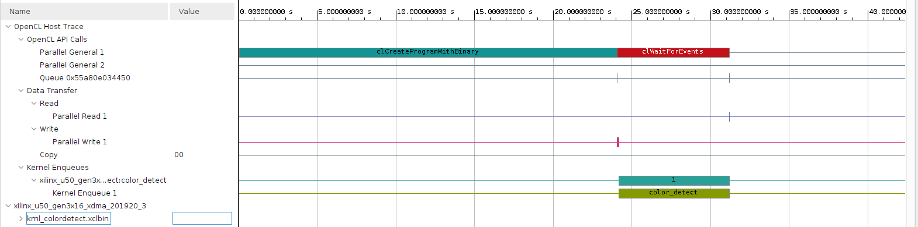
HW_emulation
Profilie summary : Kernel execution time: 1.203ms

Slide 25
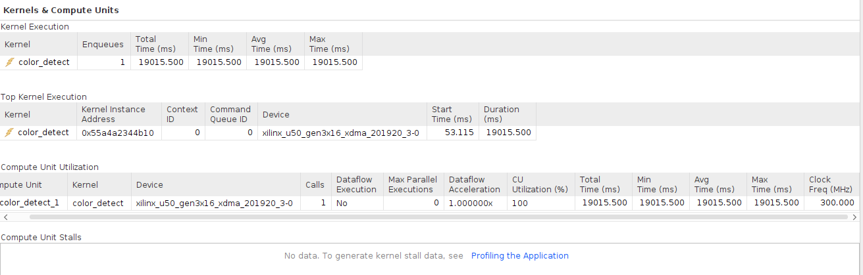
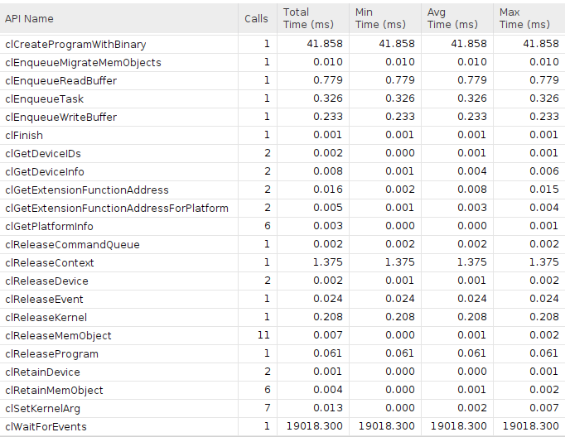
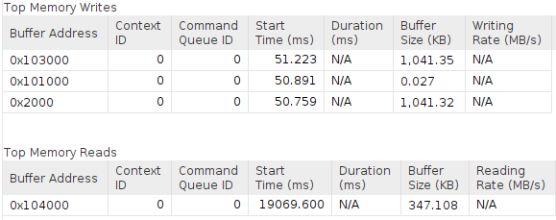

Slide 26
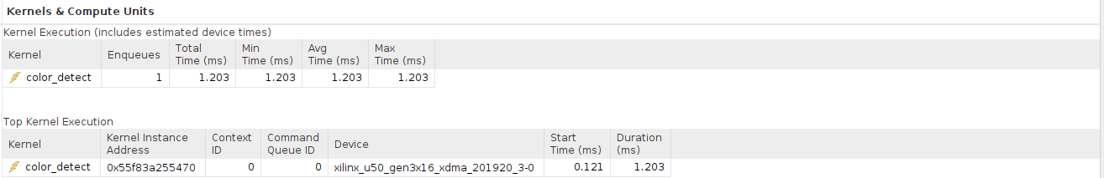
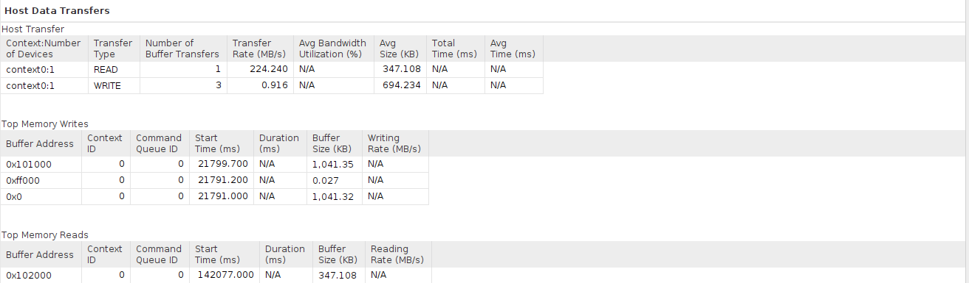
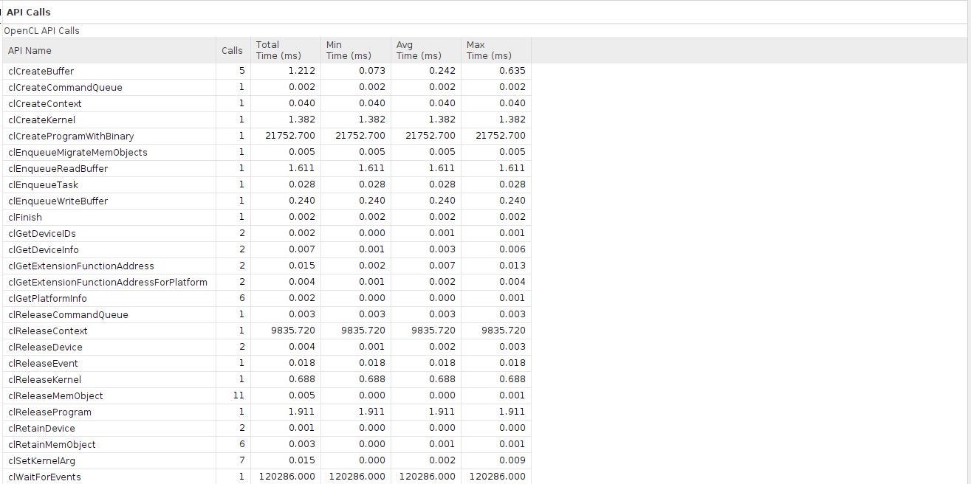

Slide 27
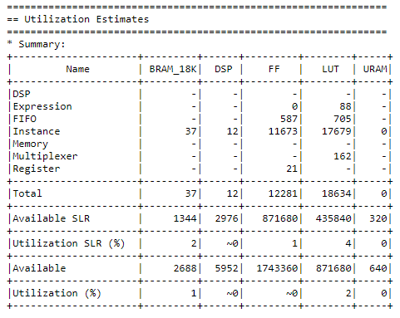
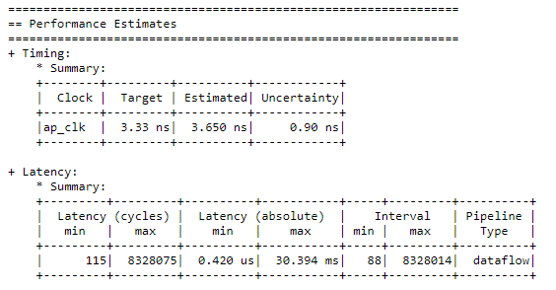
IP Synthesis Report

Slide 28
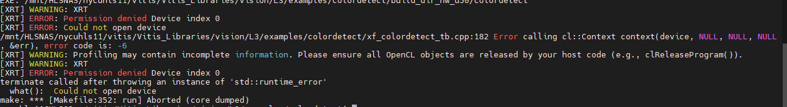
Debugging Process
Can’t find opencv path:
solution: $(SYSROOT)/usr/include/opencv4
Can’t run hardware FPGA run
Maybe ask server manager?

Slide 29
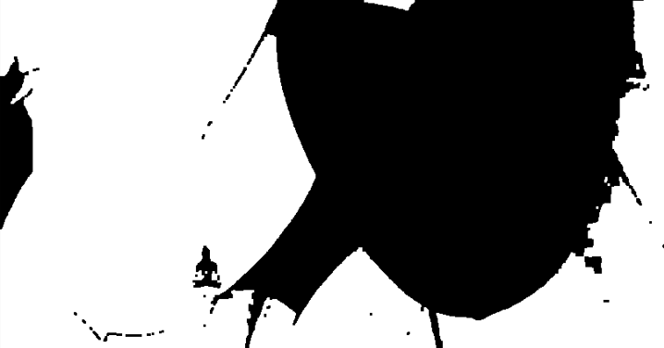

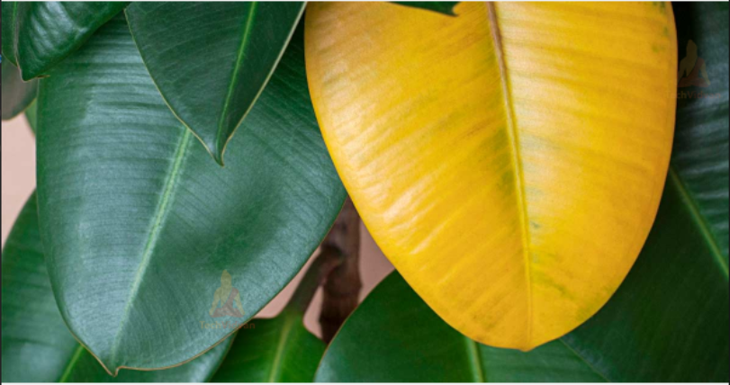
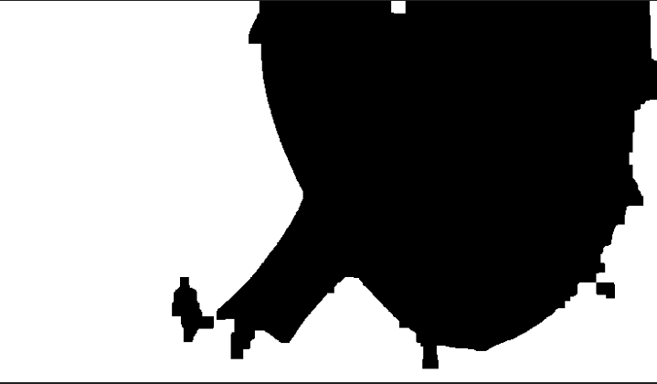
The Result of Color Detection
Yellow threshold : [50,20,20] - [100,255,255]
Increase FILTER_SIZE from 3,7,10
The erodsion and dilation can clean image better.

Slide 30

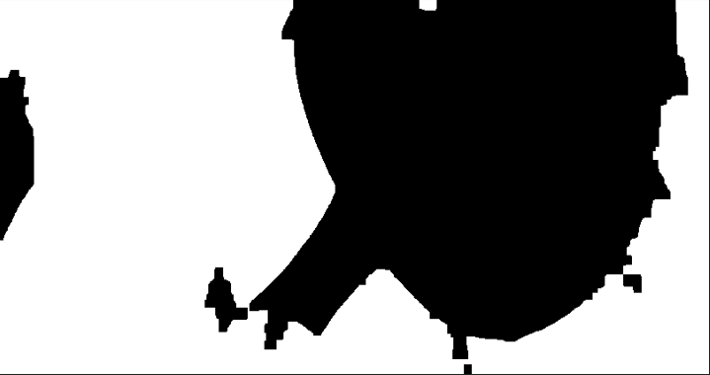
The Result of Color Detection
ITERATIONS : 1,2,4
The erodsion and dilation can clean image better.

Slide 31
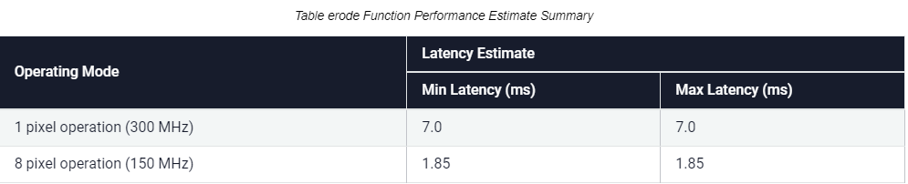
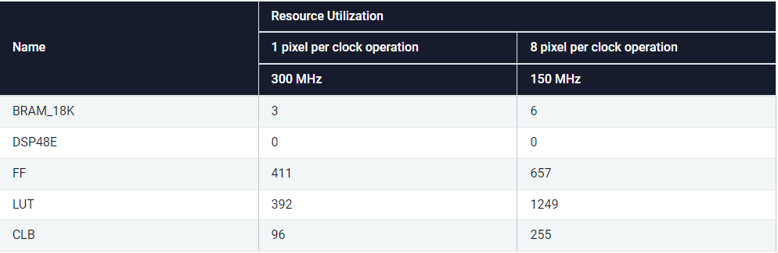
Suggestion for Improvement-1
Setting NPC argument of kernel erode and kernel dilate to accelerate.

Slide 32
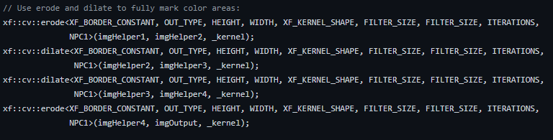
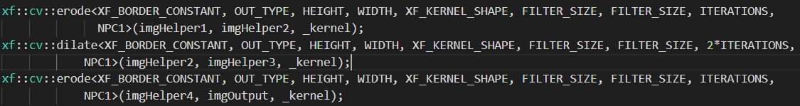
Suggestion for Improvement-2
Change the iterations number seperately.

Slide 33
Suggestion for Improvement-3
IP utilization is very low using dataflow(<1%) => Not good for FPGA.
Dataflow can deal with arbitrary input size and fixed hardware utilization
However, latency grows up by the size of input
If the input size is known and the memory is also sufficient
Optimization
Treat image as a big matrix
Using pipline or unroll mechanism to calculate mutiple pixels at same time.
Fully utilize FPGA resource to get the best performance

